Slide 1



PREDICTION OF PROFIT FOR 50 STARTUPS:
APPLICATION OF MULTIPLE LINEAR REGRESSION MODEL
Presented by: Tarun Mondal

Slide 2

TABLE OF CONTENTS
01
02
03
Objective
Solution
Business Impact
04
Thank You

Slide 3




OBJECTIVE
THE MAIN OBJECTIVE OF THIS PROJECT IS TO PREDICT THE PROFIT OF 50 START-UPS USING A MULTIPLE LINEAR REGRESSION MODEL.

Slide 4

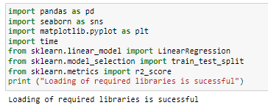
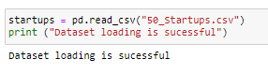
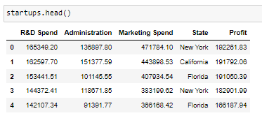
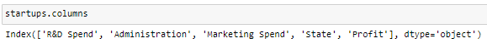
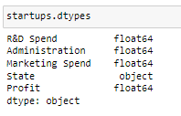
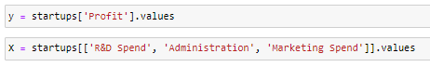
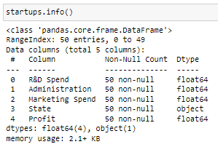
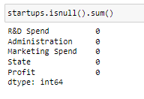
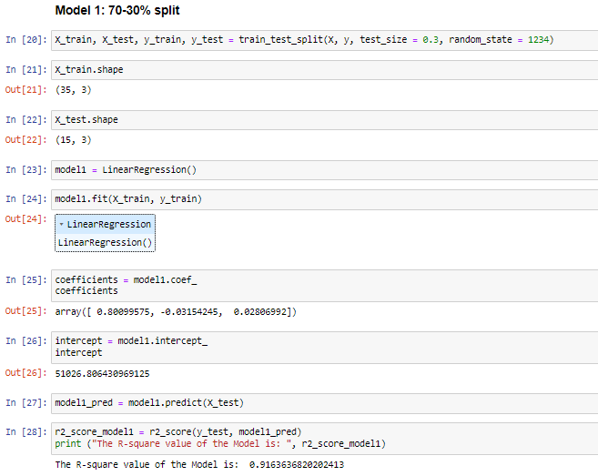
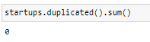
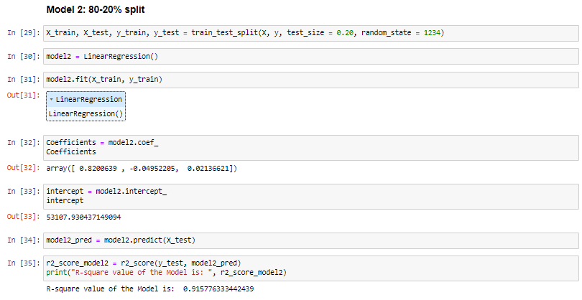
Libraries importing
Data Loading
Data Exploration
Data Splitting
Models

Slide 5





BUSINESS IMPACT
01
Prediction of Profitability of Companies
02
Evaluation of impact of R&D Spend, Marketing spend and Administration on Profitability
03
Optimal capital distribution across different organizational department

Slide 6


Thanks You

